Slide 1

7th Grade Math
Unit 13, Lesson 8 Creating Displays for Numerical Data Volume 2, pg. 275

Slide 2


Benchmark
MA.7.DP.1.5
Given a real-world numerical or categorical data set, choose and create an appropriate graphical representation.
volume 2, pg. 275

Slide 3
Integrated Mathematical Thinking and Reasoning Standards
MA.K12.MTR.1.1 Actively participate in effortful learning both individually and collectively.
MA.K12.MTR.4.1 Engage in discussions that reflect on the mathematical thinking of self and others.
MA.K12.MTR.7.1 Apply mathematics to real-world contexts.
volume 2, pg. 275

Slide 4

Learning Target
I can create an appropriate graphical representation for a numerical data set.
volume 2, pg. 275

Slide 5

Warm-Up
volume 2, pg. 276

Slide 6

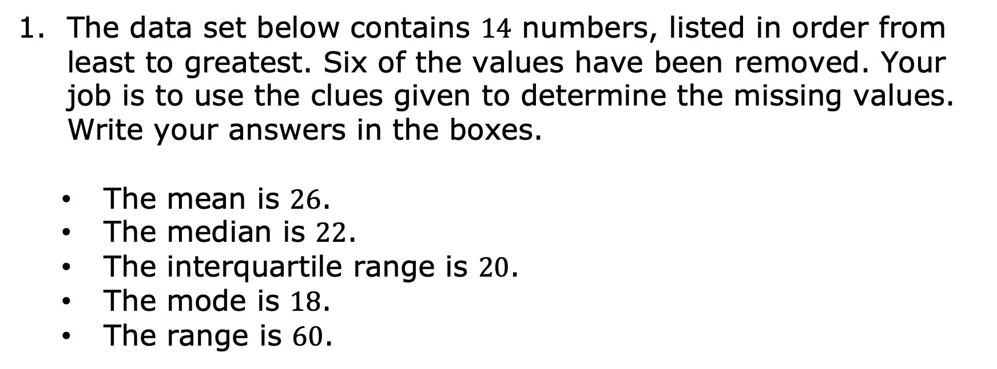
13.8.1 Warm-Up: Mystery Boxes
1. The data set below contains $14$ numbers, listed in order from least to greatest. Six of the values have been removed. Your job is to use the clues given to determine the missing values. Write your answers in the boxes.
The mean is $26$.
The median is $22$.
The interquartile range is $20$.
The mode is $18$.
The range is $60$.
volume 2, pg. 276

Slide 7

Collaboration
volume 2, pg. 276

Slide 8

13.8.2 Collaboration: Who Made It Best?
1. Dante and Lorraine are both managers of the seventh-grade basketball team. They are trying to decide which graphical representation to use to show the number of turnovers the team has had per game in the first 12 games of the season, shown in the data set below.
{2, 2, 3, 4, 4, 5, 5, 6, 7, 8, 10, 12}
volume 2, pg. 276

Slide 9
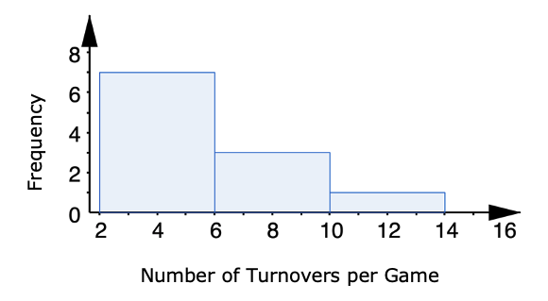
Lorraine made a histogram, as shown.
Turnovers per Game
volume 2, pg. 276

Slide 10
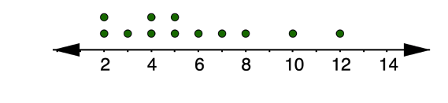
Dante made a line plot, as shown.
Turnovers in the First Twelve Games of the Season
Which of the two graphical representations shown is best to display the data?
volume 2, pg. 276

Slide 11
Explain your reasoning.
Compare your work with your partner and if necessary, resolve any differences.
Discuss with your partner whether a box plot or stem-and-leaf plot would be useful for displaying this data set. Summarize your discussion.
volume 2, pg. 277

Slide 12

Try It
volume 2, pg. 277

Slide 13

13.8.3 Try It: Creating Graphical Representations
1. Laverne and Rocco planned to travel the greatest distance between any two points in the United States of America — from Log Point, Elliot Key, Florida to Kure Atoll, Hawaii — a distance of 5,859 miles.
They took a ferry from Log Point to Miami, then drove to Los Angeles, California, where they took a plane to Hawaii. They drove anywhere from 5-8 hours a day, and kept track of how many miles they traveled per day on their trip. This information is shown below.
{224, 294, 309, 317, 321, 339, 355, 361, 383, 456, 2500}
volume 2, pg. 277

Slide 14
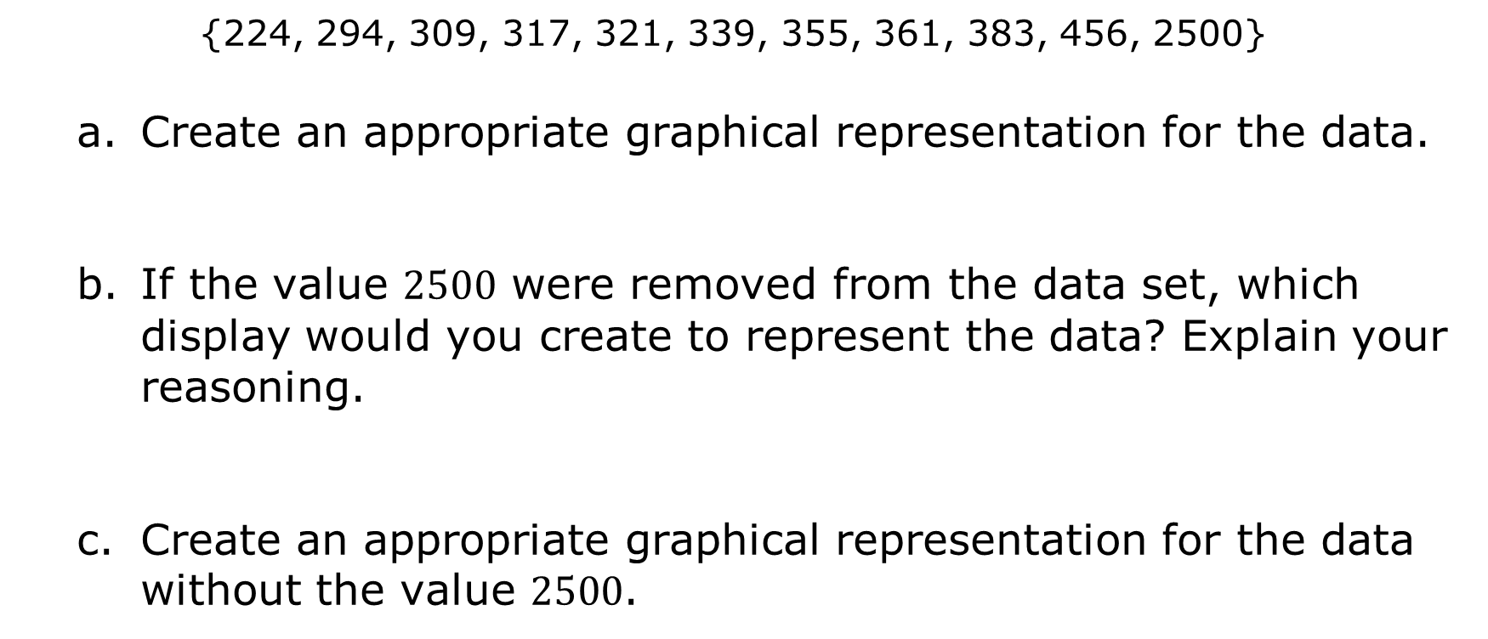
{224, 294, 309, 317, 321, 339, 355, 361, 383, 456, 2500}
Create an appropriate graphical representation for the data.
If the value $2500$ were removed from the data set, which display would you create to represent the data? Explain your reasoning.
Create an appropriate graphical representation for the data without the value $2500$.
volume #, pg. #
volume 2, pg. 277

Slide 15
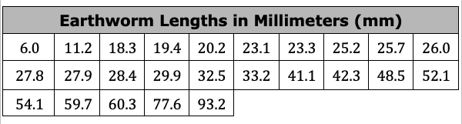
2. An earthworm farmer set up several containers of a certain species of earthworm so he could learn about their lengths. Lengths of earthworms provide information about their ages. The farmer measured the lengths of the earthworms in one container.
The farmer recorded the earthworms’ lengths, in millimeters (mm), in the table shown.
volume 2, pg. 278

Slide 16
Create an appropriate graphical representation for the data.
Explain your reasoning for choosing your display type.
If you were asked to create an additional display, which would you make and why?
volume #, pg. #
volume 2, pg. 279

Slide 17

Your Turn
volume 2, pg. 279

Slide 18

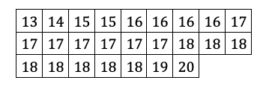
13.8.4 Your Turn!
The birth weights, in ounces,
of golden retriever puppies born at a kennel were recorded for the past month. The data is recorded in the table.
volume 2, pg. 279

Slide 19
Create an appropriate graphical display for the data.
Explain your reasoning for choosing that display type.
volume 2, pg. 279

Slide 20
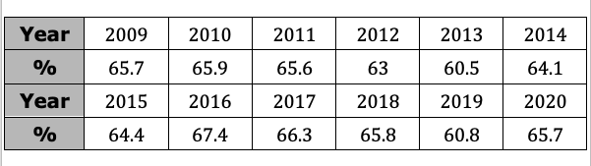
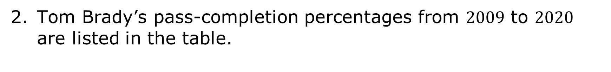
Tom Brady’s pass-completion percentages from $2009$ to $2020$ are listed in the table.
Create an appropriate graphical display for the data.
volume 2, pg. 280

Slide 21
Explain your reasoning for choosing that display type.
Compare your graph with your partner. If you created the same type of graph, explain why this graph is the best choice to represent the data. If you created different displays, discuss which graph is a better choice.
volume #, pg. #
volume 2, pg. 280

Slide 22

Wrap-Up
volume 2, pg. 281

Slide 23
13.8.5 Wrap-Up: Cool Down
What is your favorite type of graphical representation to create when displaying numerical data?
Write a note to your teacher explaining why this is your favorite type of display to create. Be specific in your explanation. You can use illustrations and examples from the lesson to help in your explanation.
volume 2, pg. 281

